Slide 1
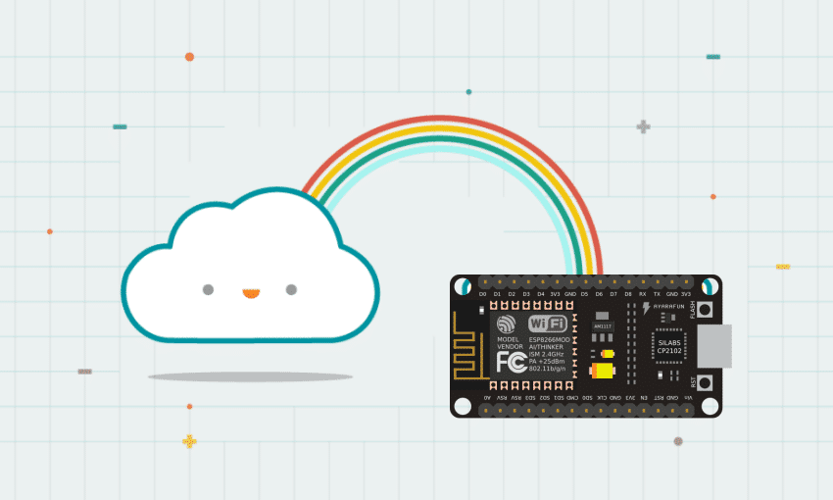
Physical Computing
This Photo by Unknown Author is licensed under CC BY-SA

Slide 2
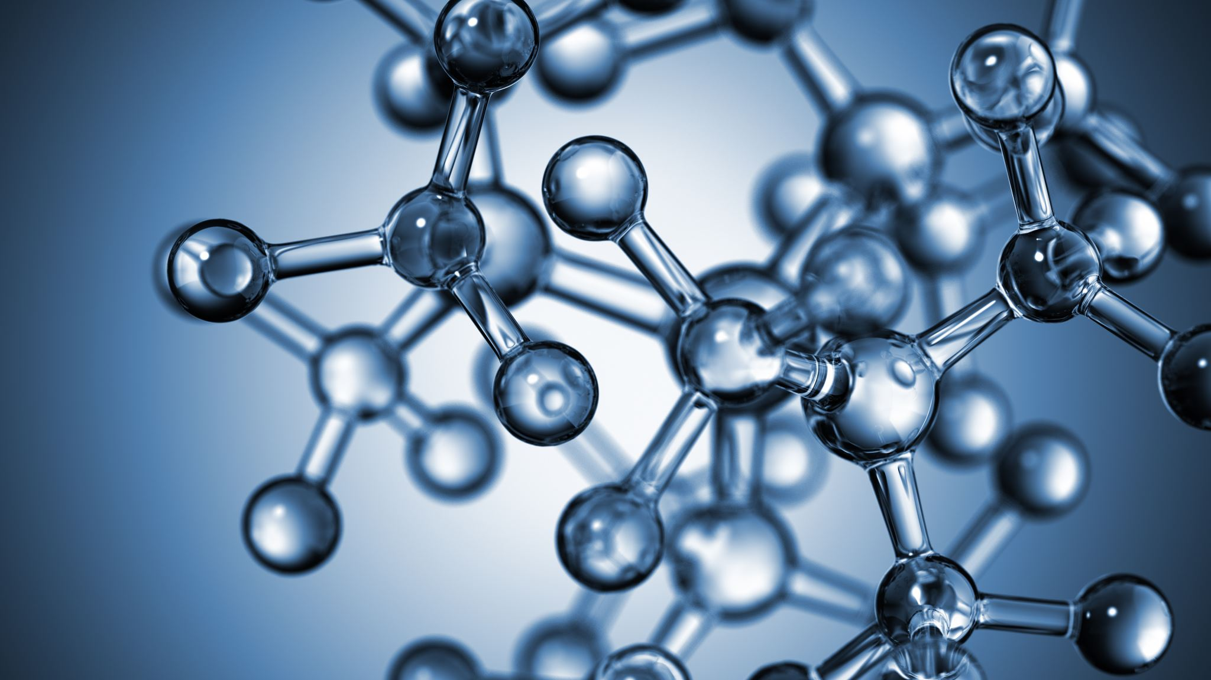
Agenda
What’s Physical Computing
Electricity
Circuits
Components
Physical Computing with the Arduino

Slide 3
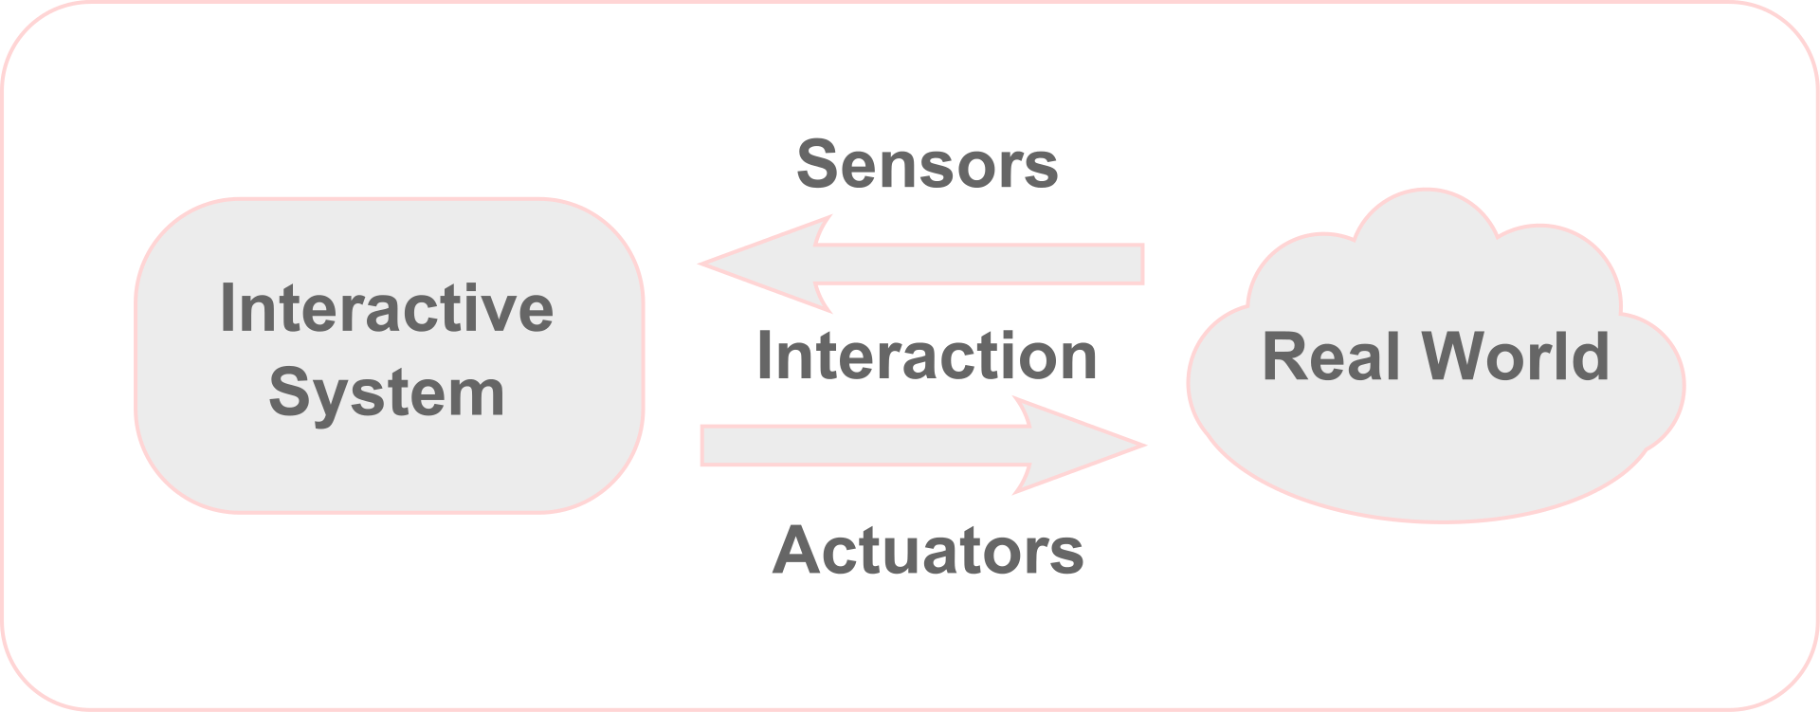
Physical Computing
A creative framework for understanding human beings' relationship to the digital world

Slide 4
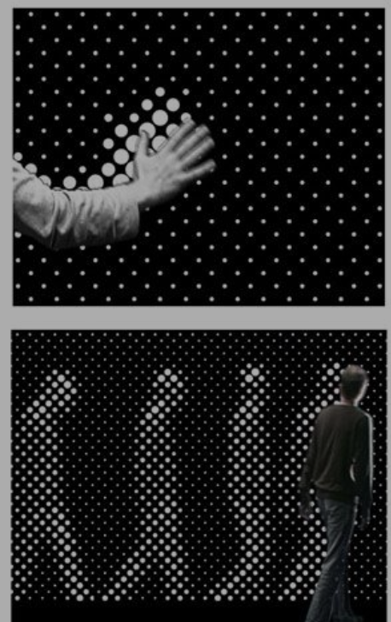
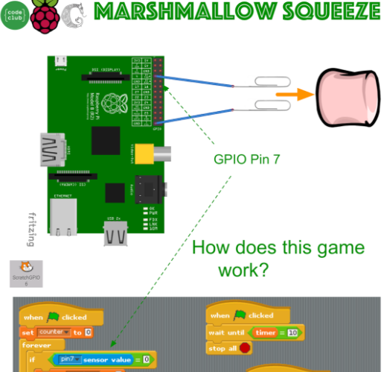
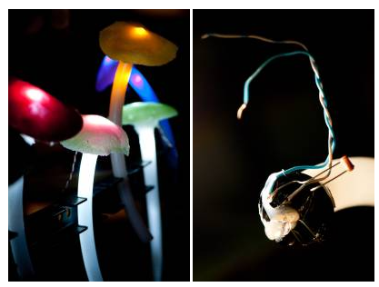
Physical Computing
Break away from conventional input/output peripherals:
Keyboard, mouse, screen
Think about how human/environment signals can be captured and changed into electronic signals that can be interpreted by a computing device.
Physical computing applications tend to depend on people for input (and sometimes output), and transform that input into another form, like an animation, a sound, or motion.
Sometimes powerfully fuses art and technology.

Slide 5
Electricity
Electricity is the flow of electrical energy through some conductive material.
Sensors are components that convert other forms of energy into electrical energy so we can read the changes in those other forms.
Transduction (e.g. microphone)
Voltage is a measure of the difference in electrical potential energy between two points in a circuit. It is measured in Volts.
Current is a measure of the magnitude of the flow of electrons through a particular point in a circuit. It is measured in Amperes, or Amps.
Resistance is a measure of a material’s ability to oppose the flow of electricity. It is measured in Ohms.
Notes:
Imagine an avalanche of snow on a mountain. The height of the mountain is analogous to the voltage; the higher the mountain, the more potential energy the falling material has. The amount of snow and rocks in the avalanche is analogous to the current. And the steepness of the mountain is analogous to the resistance: the steeper the mountain, the less it will resist the flow of the snow and rocks. We’ll define this a bit more formally below.

Slide 6
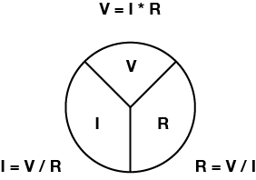
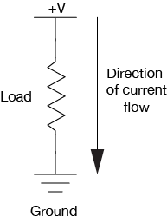
Electricity: Relationship
Voltage (V), Current (I), and Resistance (R) are all related, by the following formula:
V = I x R
electrical power (P) (measured in watts), as follows:
Watts = Volts * Amps
P = V * I

Slide 7
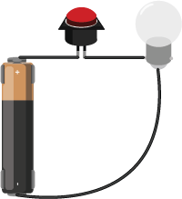
Circuit
Physical Computing usually involves interfacing a computing device with electrical circuit(s).
A circuit needs a:
Electrical Energy Source (e.g. battery)
Load (Converts elec energy to something else)
Notes:
The reason we want to build circuits is to make electricity do useful things for us. The way we do that is by putting things in the circuit that use the current flow to light up, make noise, run programs, etc.
These things are called loads, The same way you could be loaded down with too much weight, it’s possible to load down a power supply too much, which will slow down the current flow. But unlike you, it’s also possible to load down a circuit too little - this may let too much current flow (imagine running too fast if you weren’t carrying any weight), which can burn out your parts or even the power supply.

Slide 8
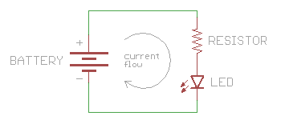
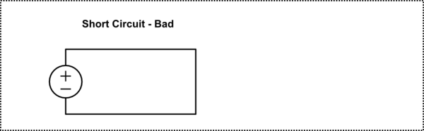
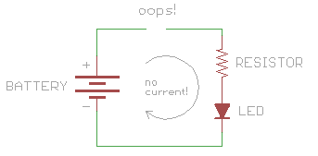
Circuit 2
Electricity needs to flow to do anything useful.
Needs a path to flow through, which must be an electrical conductor(like copper)
Electricity will flow from a higher voltage(+) to a lower voltage(-) or ground.
Notes:
Short Circuit: if you DON'T put anything in to restrict the current flow, there won't be anything to slow down the current, and it will try to be infinite! Can cause our wire to burn up, damage the power supply, drain your battery, or other exciting thing.
Too much current: A closely related problem is accidentally letting too much current flow through part of your circuit, causing a part to burn up. This isn't quite a short circuit, but it's close. This most often happens when you use the incorrect resistor value, which lets too much current flow through another component such as an LED.
Open Circuit: The opposite of a short circuit is an open circuit. This is a circuit where the loop isn't fully connected (and therefore this isn't really a circuit at all). If your circuit doesn't work, the most likely cause is an open circuit. This is usually due to a broken connection or a loose wire. (Short circuits can steal all the power from the rest of your circuit, so be sure to look for those as well.)

Slide 9
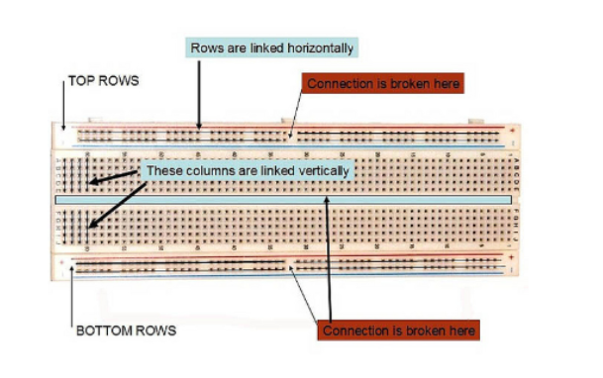
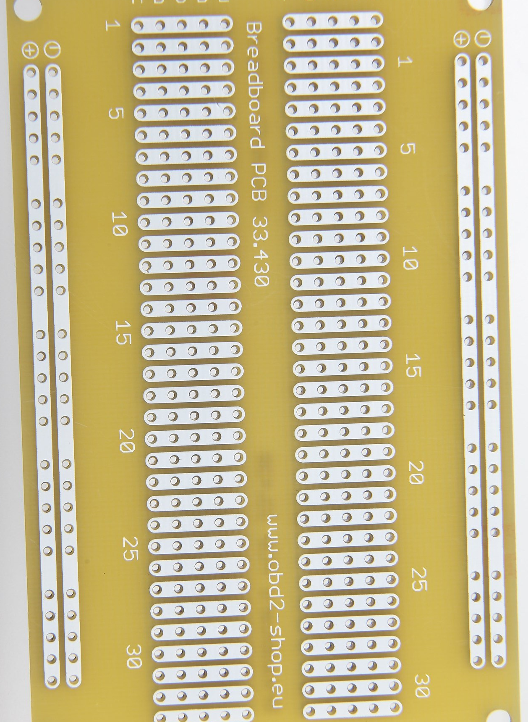
Electronics: Breadboard
Used for prototyping electronic solutions
Notes:
Terminal Strips: You can see lots of parallel rows of metal strips on the bottom of the breadboard. If you insert a component into hole, it’ll be connected to anything else placed in that row( a bit like a socket. This is because the metal rows are conductive and allow current to flow from any point in that strip.
Each row is separated by a ravine in the middle of the breadboard. This ravine isolates both sides of a given row from one another, and they are not electrically connected. Each side of a given row is disconnected from the other, leaving you with five spots for components on either side.
POWER RAILS: breadboards usually have what are called power rails that run along the sides. The metal strips that are identical to the ones in the middle , except they run the fill length of the board. When building a circuit, you tend to need power in lots of different places. The power rails give you lots of easy access to power wherever you need it in your circuit. Usually they will be labeled with a ‘+’ and a ‘-’ and have a red and blue or black stripe, to indicate the positive and negative side.
Your breadboard will have numbers and letters marked on various rows and columns. Circuits can get complicated so this helps guide you when building your circuit

Slide 10
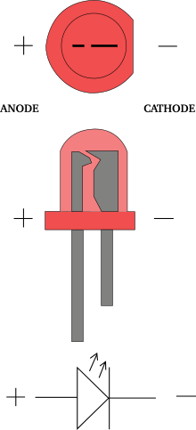
LEDs
Emits light when current passes through
Typical LED requires 2V at 20mA
RGB LEDs, LED strips, IR LEDs, Ultrabright
This Photo by Unknown Author is licensed under CC BY-SA
Notes:
permit the flow of electricity in one direction, and block it in the other direction. Because of this, they can only be placed in a circuit in one direction. Light-Emitting Diodes (LED’s) are special types of diodes which emit light when current flows through them

Slide 11
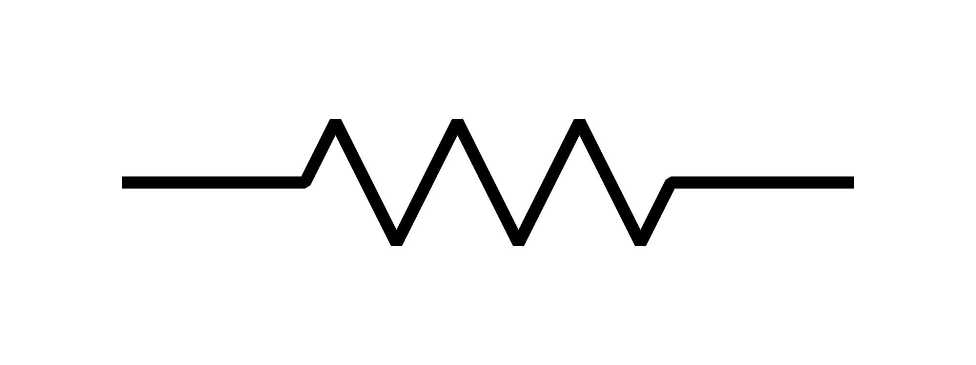
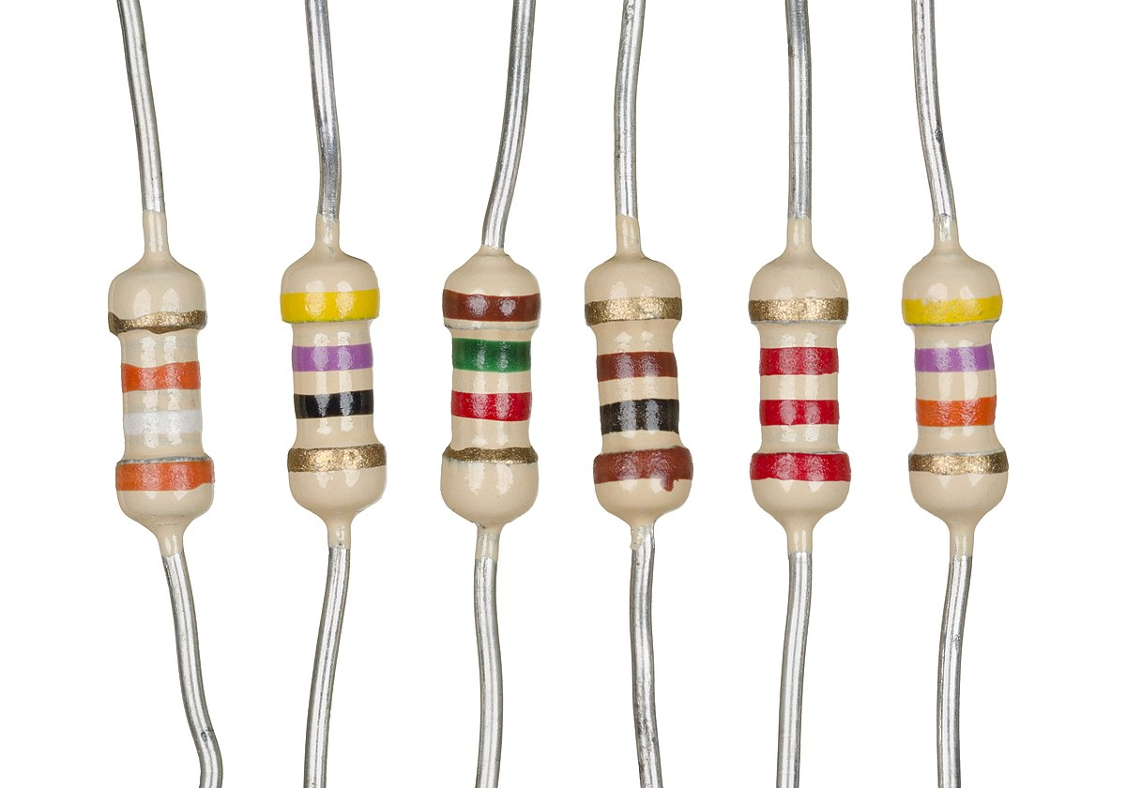
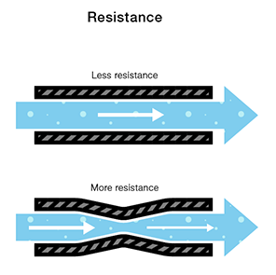
Resistors
Reduce current and voltage to components
Ohm Law: I=V/R
This Photo by Unknown Author is licensed under CC BY-SA
Notes:
resist, but do not totally block, the flow of electricity. They are used to control the flow of current. Current can move either way through a resistor, so it doesn’t matter which way they’re connected in a circuit.

Slide 12
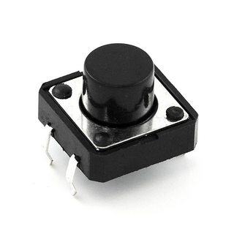

Push Button
pushbuttons control the flow of current through a junction in a circuit

Slide 13
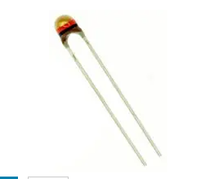
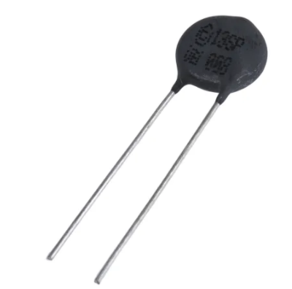
Thermistor
Thermistors are used as temperature sensors.
They can be found in every day appliances such as fire alarms, ovens and refrigerators.
They are also used in digital thermometers and in many automotive applications to measure temperature.
Resistance is dependent on temperature
combination of “thermal” and “resistor”.

Slide 14
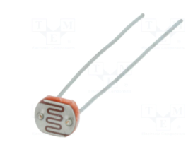
PhotoResistor
also known as a light-dependent resistor, LDR, or photo-conductive cell
Decreases resistance with respect to receiving luminosity (light) on the component’s sensitive surface
measure the light intensity

Slide 15
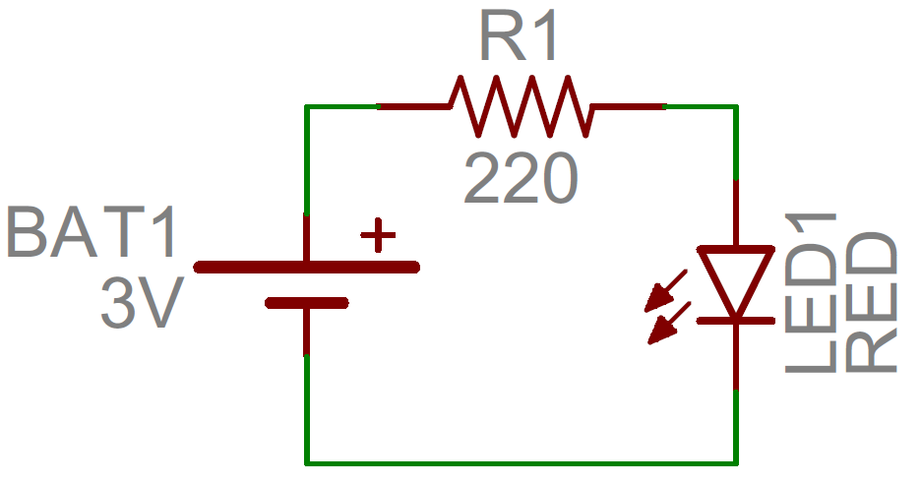
Circuit Schematics
Circuit Schematic illustrate you how components are connected in a circuit.
For more info follow this link

Slide 16
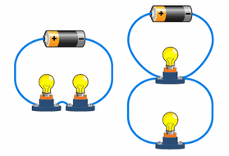
Electrical Flow
Components can be arranged in series/parallel
Current tends to follow the path of least resistance to the ground
In any given circuit, the total voltage around the path of the circuit is zero
The amount of current going into any point in a circuit is the same as the amount coming out of that point.

Slide 17
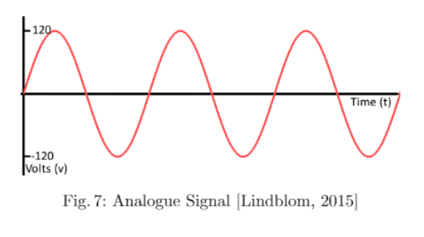
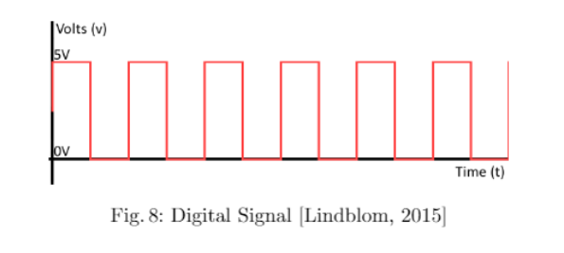
Analogue / Digital
We live in Analogue world
Infinte number of colours/sounds/smells
Technology is Digital
Finite, “discrete”
Realworld -> Digital World often requires Analogue -> Digital conversion.
Example, Photoresistor:
Analogue Voltage measured across Photoresistor is converted to digital value (a number) by Arduino

Slide 18
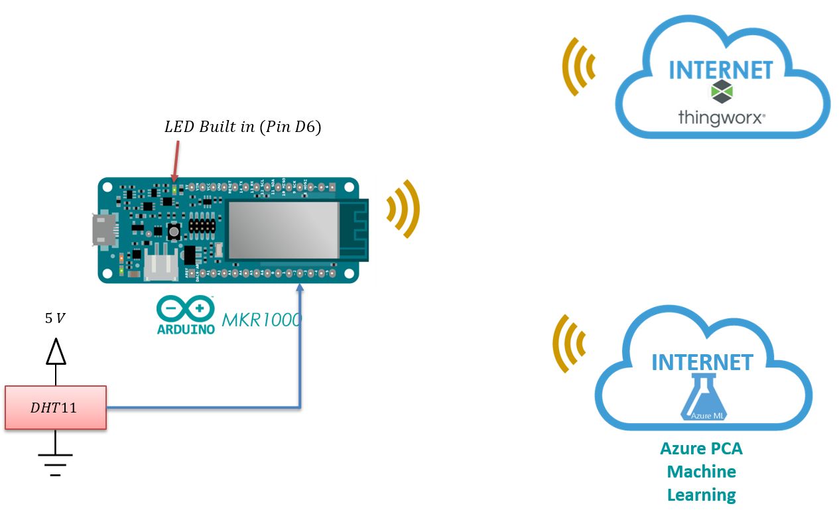
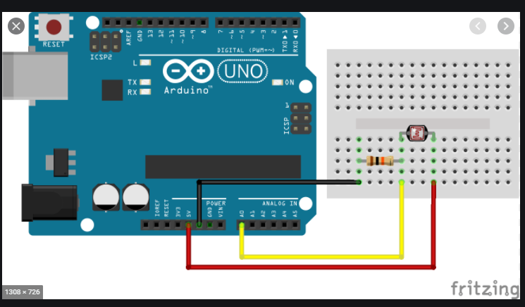
Physical Computing with Arduino

Slide 19
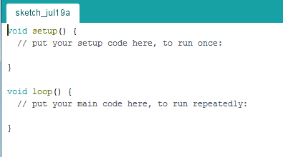
Programming with Arduino: Basics
Programs called Arduino “Sketch”
setup() function
Used to initialise stuff
loop() function
After setup(), loop() runs continuously, getting input from sensors etc.

Slide 20
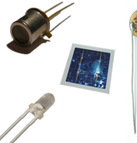
Sensors
Many IoT systems have the following characteristics:
“…ability to harvest information, the intelligence to process the information, and the connectivity capabilities to communicate the results…”
Sensors are used to “harvest information”
Sensors
receives a signal or stimulus (e.g. heat or pressure or light or motion etc.) and responds to it in a distinctive manner
produces an output signal for the purpose of sensing a physical phenomenon.

Slide 21
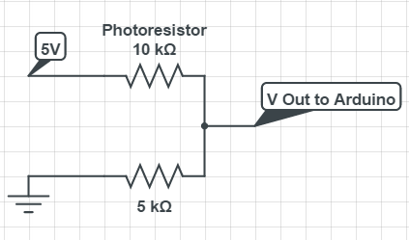
Sensor Example: Photoresistor
…”receives a signal or stimulus (e.g. heat or pressure or light or motion etc.) and responds to it in a distinctive manner…”
Input signal/stimulus: Light
Response: change in Resistance
How do we use this to “sense” light?
Put in a circuit
measure voltage across Photoresistor
Convert to digital value (a number) by Arduino
This Photo by Unknown Author is licensed under CC BY-SA

Slide 22
Sensor Example: Button
…”receives a signal or stimulus (e.g. heat or pressure or light or motion etc.) and responds to it in a distinctive manner…”
Input signal/stimulus: Mechanical (press the button)
Response: Close/Open Circuit
How do we use this to “sense” button press?
Put in a circuit
measure voltage across Button
Convert to digital value (a number) by Arduino

